Slide 1

STATATHON 2025
TITLE PAGE
Problem Statement ID: 5
Problem Statement Title:
PS Category- Software/Hardware:
Team ID:
Team Name (Registered on portal):
AI-enabled semantic search for National Classification of Occupation (NCO)
Software
3499
Data Envisors
@STATATHON Idea submission-Template
1

Slide 2
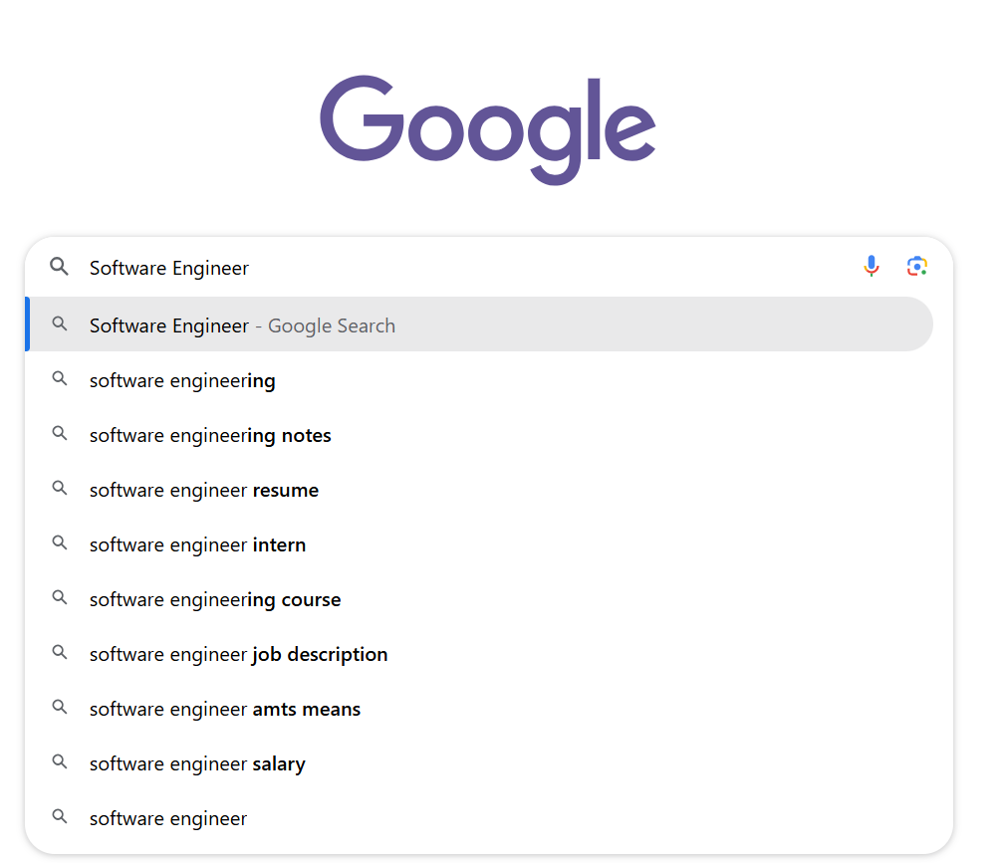

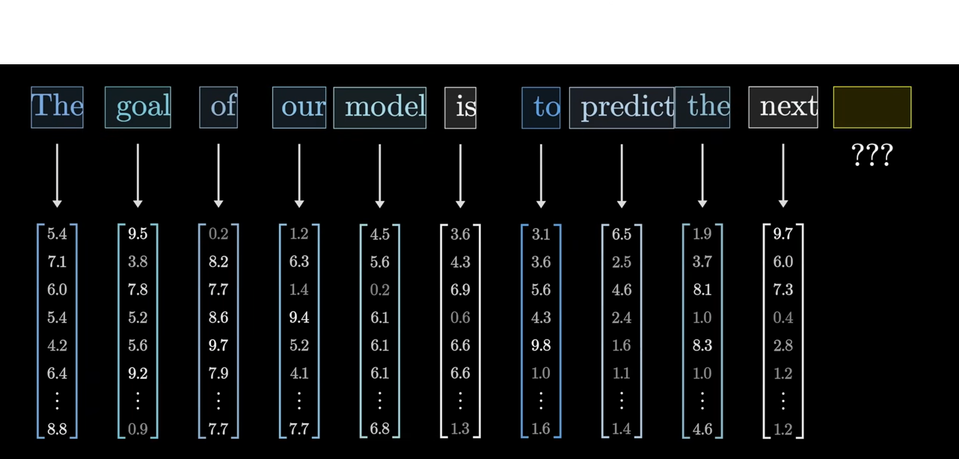



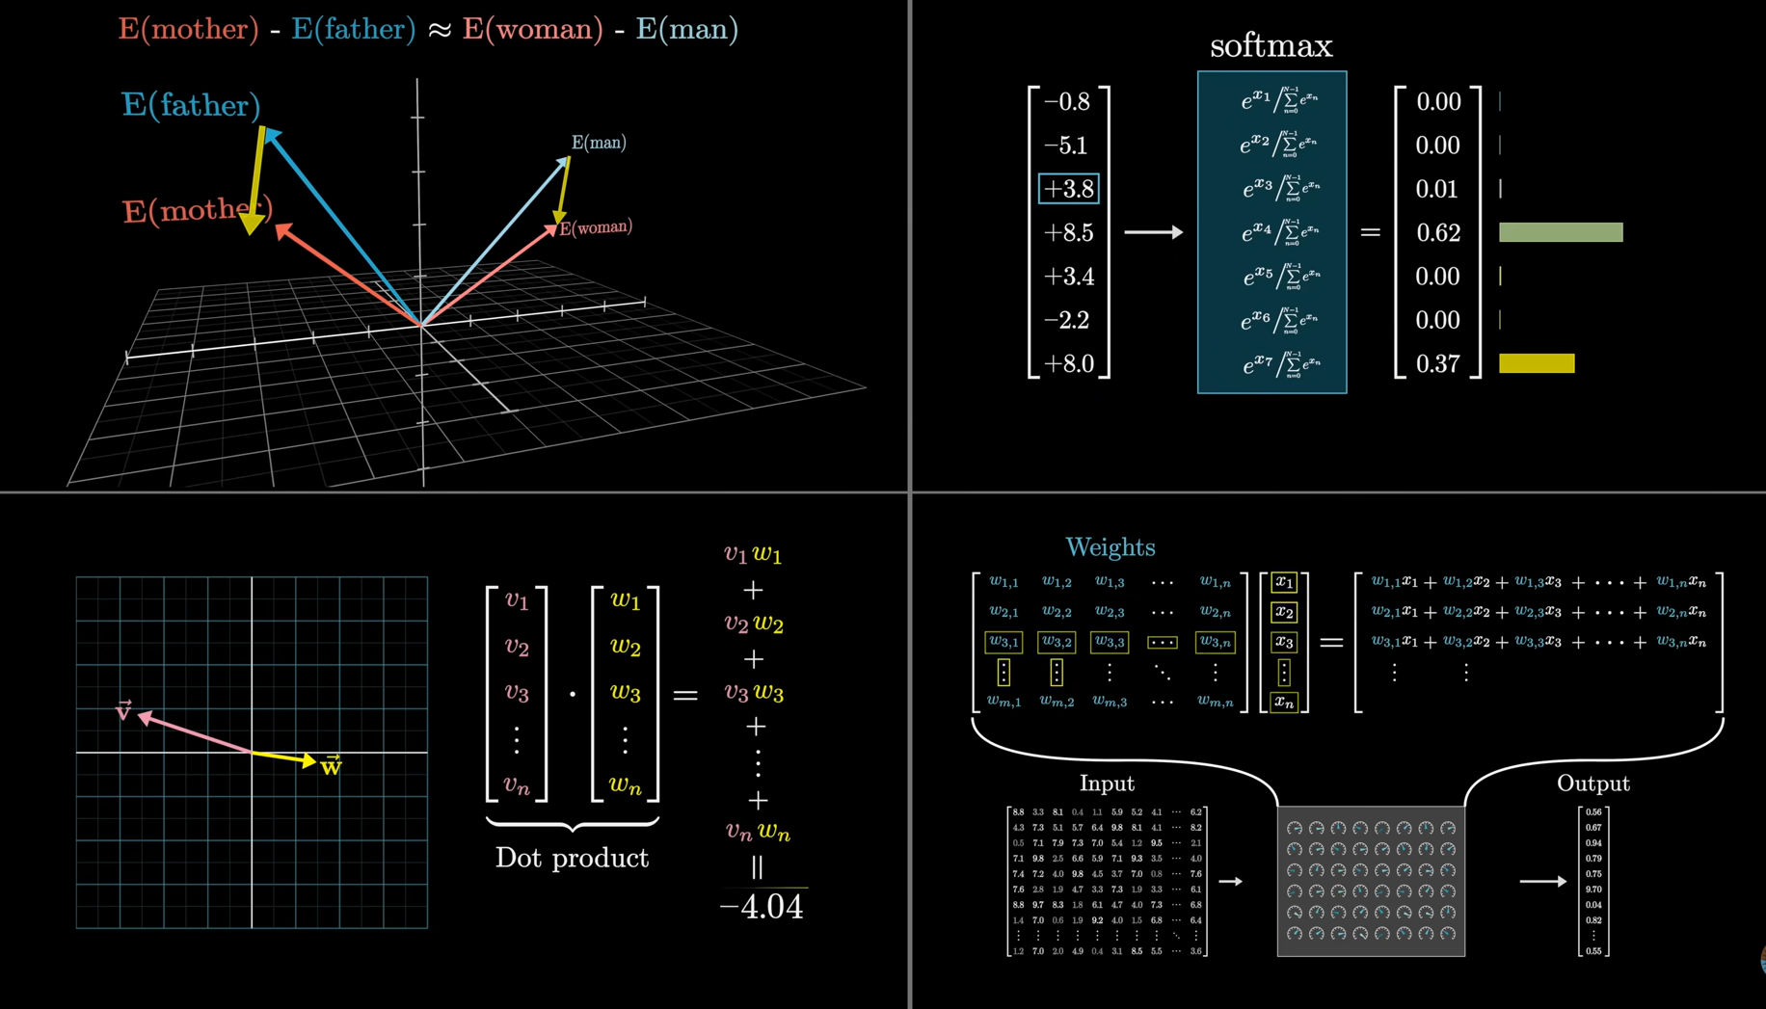
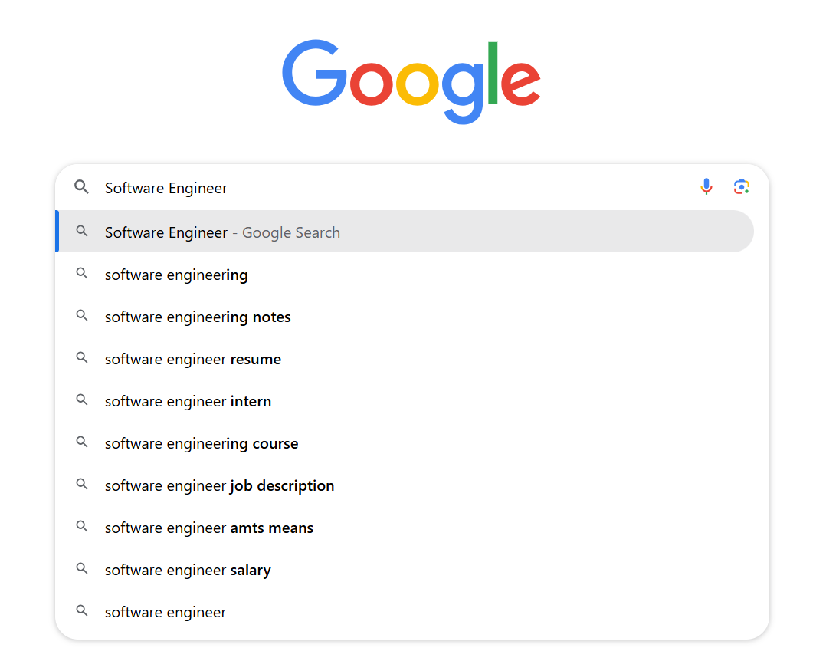


User enters a natural-language search query describing the desired job or skills.
PROBLEM STATEMENT - DESCRIPTION
Current NCO search is keyword-based and requires users to know the exact occupation title.
This limits discoverability of related jobs, as synonyms and context are ignored.
HIVE : DESCRIPTION
An AI-powered semantic search engine that understands meaning, not just words.
Uses natural language processing and vector embeddings to match user queries with relevant occupations in the NCO dataset.
Improves access to job information for seekers, recruiters, and policymakers.
Converted to Vector representation
Processing
the Query
Outputting Numbers
Top N Matching Occupations
Sematic Search
Vector Matching Engine
INNOVATION AND UNIQUENESS
Context-aware search: Retrieves jobs even when different terminology is used.
Smart ranking: Prioritizes the most relevant occupations based on semantic similarity.
Extensible design: Can be expanded to multilingual search and other datasets.

Slide 3

















Data Envisors
TECHNICAL APPROACH
Data Source & Storage
Frontend Display
React.js UI
CLOUD
Search Results
WORK FLOW
Embedding & Processing
API & Search
Output Stage
PROJECT TECH STACK
Sentence
Transformers
NLP Pipeline
Frontend
NCO
Vector Database
Programming language
Framework for APIs
DATASET
Data Processing & Semantic Search stage
Cloud hosting
&
DATA Stack
Containerization tool
3

Slide 4















Data Envisors
FEASIBILITY AND VIABILITY
FEASIBILITY
VIABILITY
1. Technical Feasibility
Pre-trained embedding models (all-MiniLM-L6-v2 / text-embedding-3-large) ready for use
FAISS / Pinecone integration with FastAPI for efficient vector search
2. Operational Feasibility
User-friendly React.js interface for non-technical users
Fast, accurate results through optimized semantic search
3. Resource Feasibility
Open-source tools minimize licensing costs
NCO dataset eliminates need for custom data collection
4. Time Feasibility
Pre-built libraries accelerate development
Modular design enables parallel frontend & backend work
Alignment with UN SDGs ensures long-term social, economic, and environmental relevance.
Improves access to job opportunities through context-aware search.
Enhances labour market efficiency by connecting talent with the right roles.
Supports career mobility by revealing related occupations.
SDG 8
Brings AI innovation to public job databases.
Creates a scalable, tech-enabled search system.
Promotes adoption of advanced search technology in government platforms.
Helps students and counselors link skills and training to occupations.
Guides institutions to align courses with in-demand skills.
Enables informed career planning.
SDG 4
SDG 9
HIVE
@STATATHON Idea submission-Template
4
4

Slide 5














Data Envisors
IMPACT AND BENEFITS
BENEFITS
MARKET DEMAND & IMPACT
Improved Job Accessibility
Increased Employment Opportunities
Convenience and Speed
Skill-to-Job Mapping
Inclusive Access
Better Career Guidance
Government Data Utilization
Scalable and Future-Ready
Government Adoption Job Portals Integration
Career Counseling Platforms
Expansion to Other Domains
Skill Development Programs
AI-powered Analytics
@STATATHON Idea submission-Template
5

Slide 6






Data Envisors
RESEARCH AND REFERENCES
1. National Classification of Occupations (NCO) 2015 – Ministry of Labour & Employment
Official dataset containing job codes, titles, and descriptions.
https://labour.gov.in
2. Semantic Search in AI
“Semantic Search: The Future of Information Retrieval” – IEEE Xplore
Explains how embeddings and vector databases improve contextual search.
3. Vector Databases
FAISS (Facebook AI Similarity Search) – Open-source library for efficient similarity search.
https://faiss.ai
4. Embedding Models
Sentence Transformers Documentation – For generating text embeddings.
https://www.sbert.net
5. Government Data Utilization
World Bank Report on the use of open data for economic growth.
6. Related Hackathon Problem Statements
Past use cases in data dissemination and job-matching AI tools from similar competitions.
@STATATHON Idea submission-Template
6

